Slide 1


INSTITUTE - UIE
DEPARTMENT- ACADEMIC UNIT-2
Bachelor of Engineering (Computer Science & Engineering)
Subject Name: Introduction to Problem Solving
Code:22CSH-101
CHAPTER NAME -FUNCTIONS

Slide 2

Course objectives
OBJECTIVES
The course aims to provide exposure to problem solving with programming
The course aims to raise the programming skills of students via logic building capability
With the knowledge of C language students would be able to model real world problems

Slide 3



CO Number | Course Outcome
CO1 | Remember the concepts related to fundamentals of C language, draw flowcharts and write algorithm/pseudocode.
CO2 | Understand the way of execution and debug programs in C language.
CO3 | Apply various constructs, loops, functions to solve mathematical and scientific problem.
CO4 | Analyze the dynamic behavior of memory by the use of pointers.
CO5 | Design and develop modular programs for real world problems using control structure and selection structure.

Slide 4
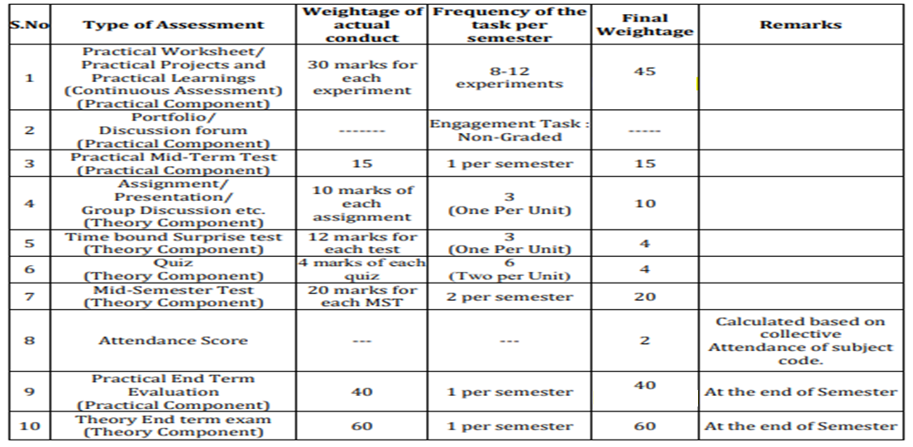
Scheme of Evaluation

Slide 5
Recursive Function
CONTENT
Examples of Recursive functions
Macros
References

Slide 6
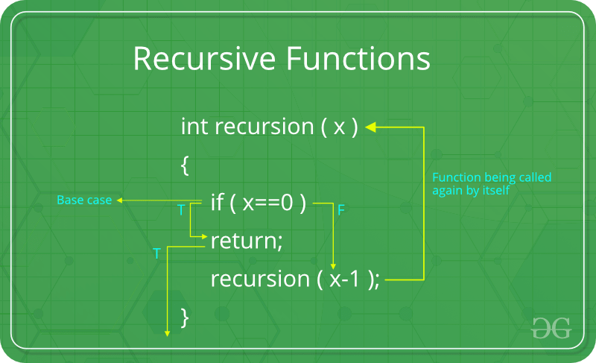
Definition: The process in which a function calls itself directly or indirectly is called recursion and the corresponding function is called as recursive function. Using recursive algorithm, certain problems can be solved quite easily.
RecursiveFunction

Slide 7
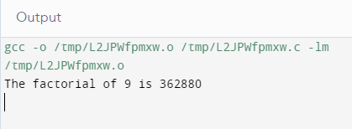
Example1: Program to find factorial of a number.
#include <stdio.h>
int factorial(int number);
int main()
{
int x = 9;
printf("The factorial of %d is %d\n", x, factorial(x));
return 0;
}
int factorial(int number)
{
if (number == 1)
return (1); /* exiting condition */
else
return (number * factorial(number - 1));
}
Example 1
Recursive Function

Slide 8
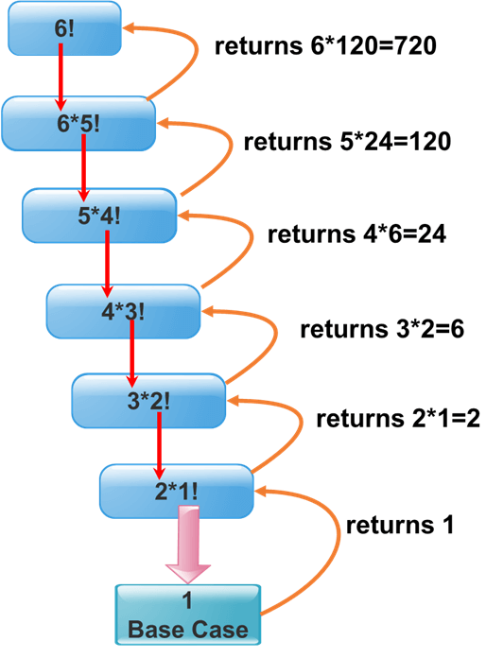
1. We declare our recursive factorial function which takes an integer parameter and returns the factorial of this parameter. This function will call itself and decrease the number until the exiting, or the base condition is reached. When the condition is true, the previously generated values will be multiplied by each other, and the final factorial value is returned.
2. We declare and initialize an integer variable with value"6" and then print its factorial value by calling our factorial function.
Explanation of Example 1

Slide 9
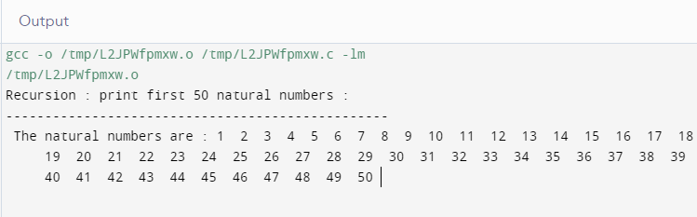
Example2: Write a program in C to print first 50 natural numbers using recursion.
#include<stdio.h>
int numPrint(int);
int main()
{
int n = 1;
printf("\n\n Recursion : print first 50 natural numbers :\n");
printf("-------------------------------------------------\n");
printf(" The natural numbers are :");
numPrint(n);
printf("\n\n");
return 0;
}
int numPrint(int n)
{
if(n<=50)
{
printf(" %d ",n);
numPrint(n+1);
}
}
Example 2
Recursive Function

Slide 10
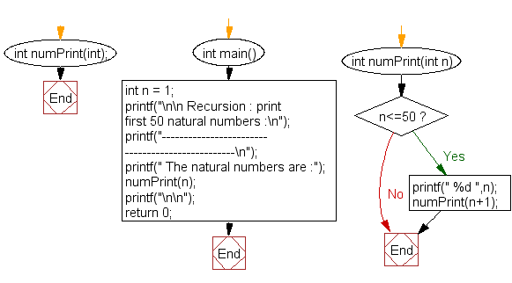
Explanation of Example 2
Using Flowchart

Slide 11
Macros: They are basically a fragment of the code that has been given a name. The name is replaced by the contents of the macro, whenever the name is used.
A macro is an operation defined in #define preprocessor directive. As with symbolic constants, the macro-identifier is replaced in the program with the replacement-text before the program is compiled.
Macros may be defined with or without arguments. - A macro without arguments is processed like a symbolic constant while a macro with arguments, the arguments are substituted in the replacement text, then the macro is expanded, that is the replacement-text replaces the identifier and argument list in the program
Macros

Slide 12
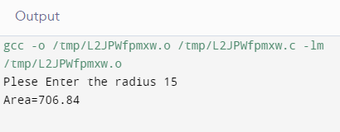
Example: Program to calculate area of circle using macros.
#include
#define PI 3.1415
int main()
{
float radius,area;
printf("Plese Enter the radius ");
scanf("%f", &radius);
//Here used the value of PI
area = PI*radius*radius;
printf("Area=%.2f",area);
return 0;
}
Example of Macros
Wherever Pi used in program it is replaced by its value

Slide 13
SUMMARY…..
We covered Recursive function
Also covered topic Macros

Slide 14
FREQUENTLY ASKED QUESTIONS
PROGRAMS
1. Write a program in C to calculate the sum of numbers from 1 to n using recursion.
2. Program of fibonacci program using recursion
3. C program to calculate length of the string using recursion
4. Program to count digits in C using recursion

Slide 15
1. What will be the value retuned by the following function, when it is called with a value 11? recur(int num) if ( ( num/2) !=0 ) return ( recur(num/2 ) * 10+num%2 ); else return 1;
A.Function does not return any value, because it goes into an infinite loop
B.11
C.1011
D. None of the above
2. What will be the output of the following C code?
#include<stdio.h>main()
{ int n; n=f1(4);
printf("%d",n);
}f1(int x)
{ int b; if(x==1)
return 1;
else
b=x*f1(x-1);
return b;}
a) 24 b) 4 c) 12 d) 10
UTILISE YOUR KNOWLEDGE TO ANSWER
Let us see how much you have learned from the lecture and how effectively you can apply your knowledge…!!

Slide 16
3. In the absence of a exit condition in a recursive function, the following error is given __________ a) Compile time error b) Run time error c) Logical error d) No error
4. Iteration requires more system memory than recursion. a) True b) False
UTILISE YOUR KNOWLEDGE TO ANSWER
Let us see how much you have learned from the lecture and how effectively you can apply your knowledge…!!

Slide 17
Vedio Lecture:
https://nptel.ac.in/courses/106/105/106105171/
http://www.nptelvideos.com/lecture.php?id=6625
https://www.digimat.in/nptel/courses/video/106105171/L01.html
Websites: https://www.programiz.com/c-programming/c-recursion
https://www.cprogramming.com/tutorial/c/lesson16.html
https://www.phptpoint.com/recursive-function-in-c/
https://www.tutorialspoint.com/macros-and-preprocessors-in-c
REFERENCES
Vedio Lectures
Weblinks

Slide 18
THANK YOU….

